Slide 1
Picture of the speaker

Slide 2
Picture of the speaker

Slide 3
Picture of the speaker

Slide 4
Picture of the speaker

Slide 5
Keynote speech

Slide 6
Keynote speech

Slide 7
Group photo

Slide 8
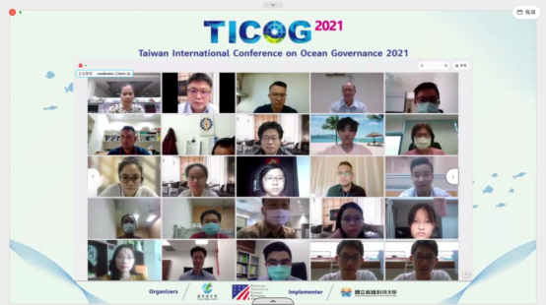
Group photo

